Slide 1

MAEER’s MIT Art, Design and Technology University, Pune
MIT School of Computing
Department of Computer Science and Engineering
Computer Engineering Workshop 23CSE1107
F.Y B.Tech [ASH] A.Y 2023-24 Sem-II
CEW Project Presentation
A presentation on
“Micro Algae Based Air Purifier ”
by
Achyut Yesare [SOC16-02][ADT23SOCB0041]
Vedant Barhate [SOC16-55][ADT23SOCB1288]
Vibhor Dev [SOC16-56][ADT23SOCB1303]
Yash Pandey [SOC16-57][ADT23SOCB1337]
Shravan Mehta [SOC16-62][ADT23SOCB1560]
of F.Y. BTech [CSE]
Under the guidance of
Prof. Pranav Chippalkatti
[Assistant Prof(EEE-CSE) & Incharge(CEW)]

Slide 2
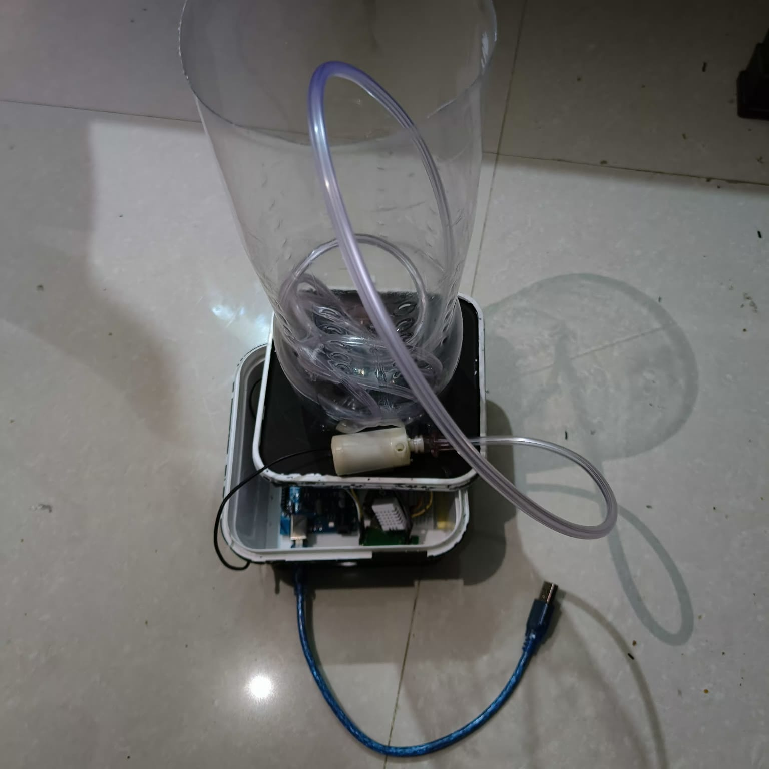
MAEER’s MIT Art, Design and Technology University, Pune
MIT School of Computing
Department of Computer Science and Engineering
Computer Engineering Workshop 23CSE1107
F.Y B.Tech [ASH] A.Y 2023-24 Sem-II
CEW Project Presentation
Outline : “Micro Algae Based Air Purifier ”
❖Objective
❖Introduction
❖Problem Statement
❖Empathy Chart
❖Point of View Statement
❖Ideation
❖Block Diagram
❖Flowchart
❖Algorithm
❖Results
❖Conclusion

Slide 3
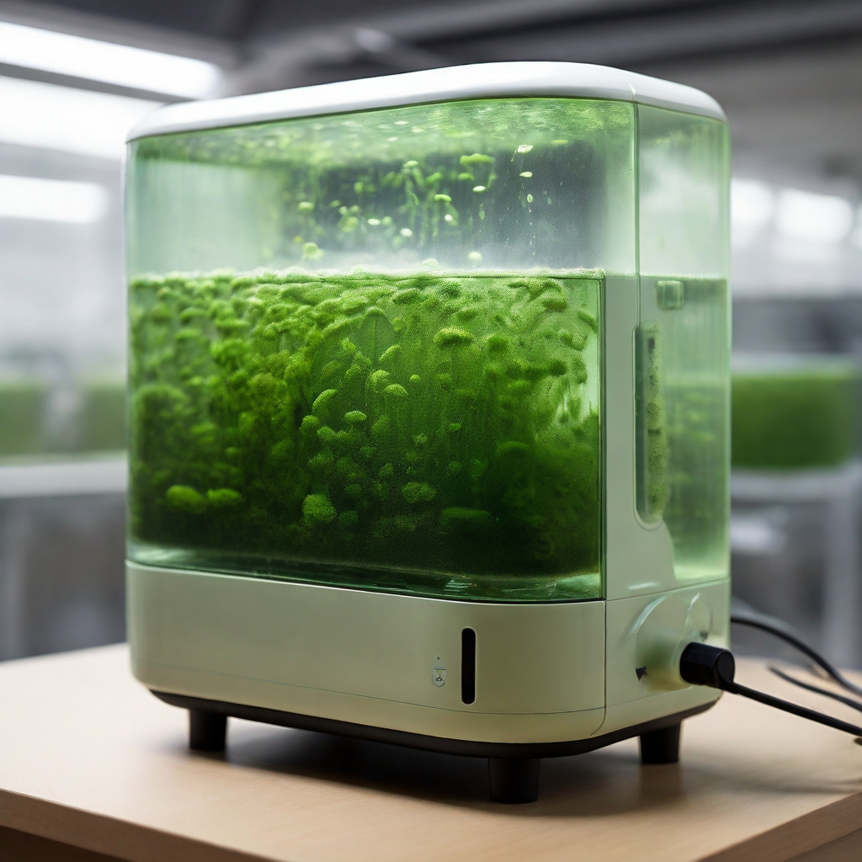
MAEER’s MIT Art, Design and Technology University, Pune
MIT School of Computing
Department of Computer Science and Engineering
Computer Engineering Workshop 23CSE1107
F.Y B.Tech [ASH] A.Y 2023-24 Sem-II
CEW Project Presentation
❖Objective
Our goal is to use tiny plants called microalgae to clean up the air for residential areas. We want to make a special system that's really good at getting rid of the bad stuff in the air, like pollution. We'll test how well it works and see if it's something that can be used everywhere in residential areas.

Slide 4
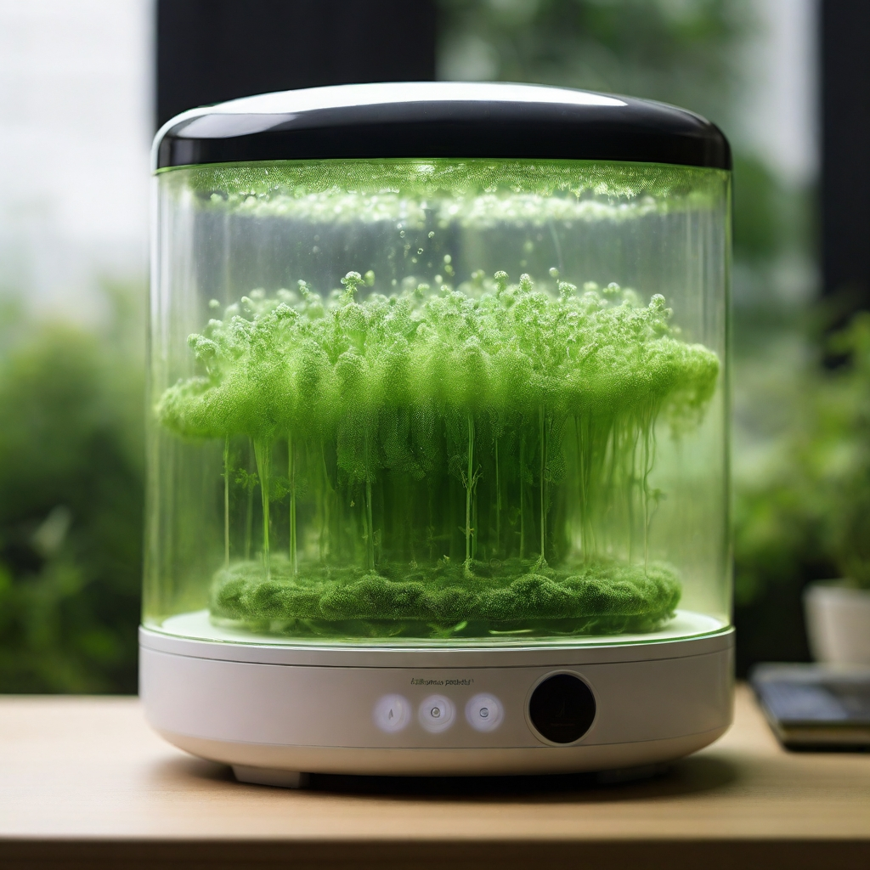
MAEER’s MIT Art, Design and Technology University, Pune
MIT School of Computing
Department of Computer Science and Engineering
Computer Engineering Workshop 23CSE1107
F.Y B.Tech [ASH] A.Y 2023-24 Sem-II
CEW Project Presentation
❖Introduction
In our residential areas, the air we breathe isn't as clean as it should be. There's a lot of pollution from cars, factories, and other things. We need to find better ways to clean up this dirty air. That's where our project comes in. We're looking at using tiny plants called microalgae to help make the air cleaner.
These microalgae are like superheroes that can absorb the bad stuff in the air and give out fresh, clean air in return. Our goal is to create a special system that uses these microalgae to clean up the air in our residential areas.

Slide 5
MAEER’s MIT Art, Design and Technology University, Pune
MIT School of Computing
Department of Computer Science and Engineering
Computer Engineering Workshop 23CSE1107
F.Y B.Tech [ASH] A.Y 2023-24 Sem-II
CEW Project Presentation
❖Problem Statement
Air pollution is a significant challenge in residential areas, characterized by high levels of pollutants such as particulate matter, nitrogen oxides, and volatile organic compounds.
Who needs cleaner air and healthier environments?
Residents of Indian cities, including families, children, and the elderly, require cleaner air and healthier environments to live and thrive.
Why do they need it?
They need it because exposure to polluted air can lead to various health problems, including respiratory issues, cardiovascular diseases, and decreased overall well-being. Additionally, pollution harms the environment, affecting ecosystems and biodiversity.
Our goal is to develop a solution that effectively reduces air pollution and improves air quality in Indian cities, providing residents with cleaner and healthier surroundings.

Slide 6
MAEER’s MIT Art, Design and Technology University, Pune
MIT School of Computing
Department of Computer Science and Engineering
Computer Engineering Workshop 23CSE1107
F.Y B.Tech [ASH] A.Y 2023-24 Sem-II
CEW Project Presentation
❖Empathy Chart
Users’ Feelings: Users might feel intrigued by the innovative use of microalgae and hopeful about its potential environmental benefits.
Users’ Actions: Potential actions include researching the technology, purchasing the product, or recommending it to others.
Users’ Thoughts: They may think about the effectiveness of the purifier, its cost, and how it compares to traditional purifiers.
Micro Algae Based Air Purifier
Impact on Environment: The purifier could have a positive impact by reducing air pollutants and contributing to a cleaner atmosphere.

Slide 7
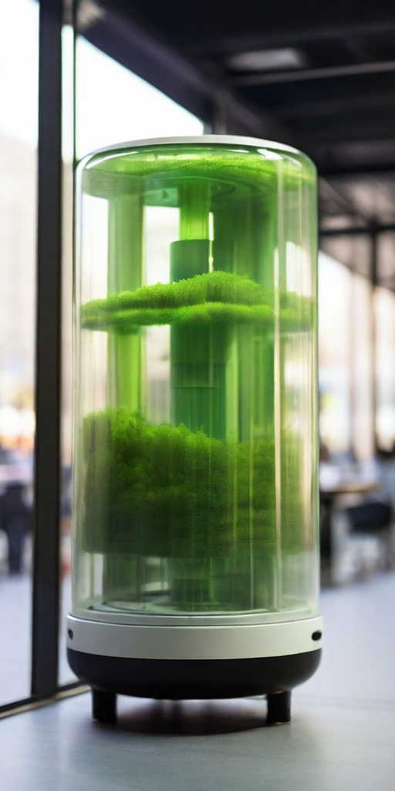
MAEER’s MIT Art, Design and Technology University, Pune
MIT School of Computing
Department of Computer Science and Engineering
Computer Engineering Workshop 23CSE1107
F.Y B.Tech [ASH] A.Y 2023-24 Sem-II
CEW Project Presentation
❖Point of View Statement
We care about making the air cleaner in residential area. because we believe everyone deserves to breathe fresh and healthy air. We know that the current ways of cleaning the air aren't good enough, so we're looking for new solutions. We think using microalgae to clean the air could be a great idea. By working together, we want to make our cities healthier and better places to live.

Slide 8
MAEER’s MIT Art, Design and Technology University, Pune
MIT School of Computing
Department of Computer Science and Engineering
Computer Engineering Workshop 23CSE1107
F.Y B.Tech [ASH] A.Y 2023-24 Sem-II
CEW Project Presentation
❖Ideation
Sr.No | Requirement | Proposed Solution
1 | Collection of pollution data | Uses of Air pollution sensor like PMS7003 & MHZ19
2 | Pumping air to algae | Using pump which is controlled By microcontroller on the basis of data from sensors.

Slide 9
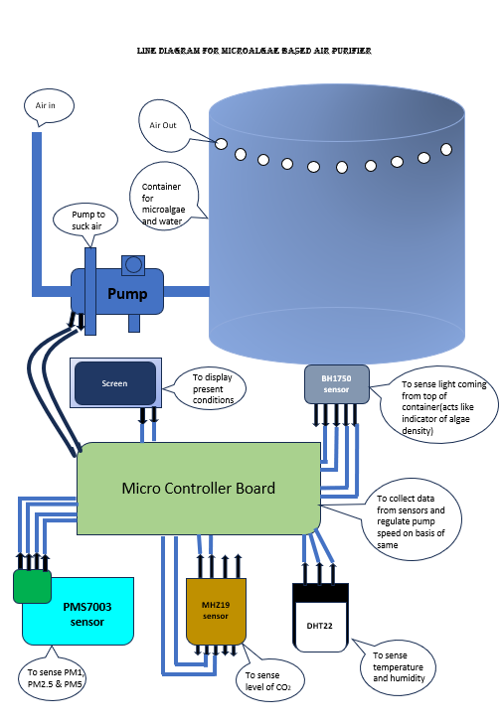

MAEER’s MIT Art, Design and Technology University, Pune
MIT School of Computing
Department of Computer Science and Engineering
Computer Engineering Workshop 23CSE1107
F.Y B.Tech [ASH] A.Y 2023-24 Sem-II
CEW Project Presentation
❖Block Diagram

Slide 10
MAEER’s MIT Art, Design and Technology University, Pune
MIT School of Computing
Department of Computer Science and Engineering
Computer Engineering Workshop 23CSE1107
F.Y B.Tech [ASH] A.Y 2023-24 Sem-II
CEW Project Presentation
❖Algorithm
1. Identify the Problem:
- Understand air pollution in residential areas.
2. Define User Needs:
- Recognize the need for cleaner air for residents.
3. Generate Insights:
- Learn about pollution sources and effects.
4. Develop Solution:
- Create microalgae-based air purification systems.
5. Collaboration and Action:
- Work with others to implement solutions.
6. Evaluation and Adjustment:
- Monitor and adjust solutions as needed.
7. Impact Assessment:
- Measure the effects of solutions on health and environment.
8. Continuous Improvement:
- Keep improving to fight air pollution effectively.

Slide 11
MAEER’s MIT Art, Design and Technology University, Pune
MIT School of Computing
Department of Computer Science and Engineering
Computer Engineering Workshop 23CSE1107
F.Y B.Tech [ASH] A.Y 2023-24 Sem-II
CEW Project Presentation
❖Flowchart
Start
Get pollution data
Display Data
If condition satisfies
F
Turn off pump
T
T
Turn on pump
Stop

Slide 12
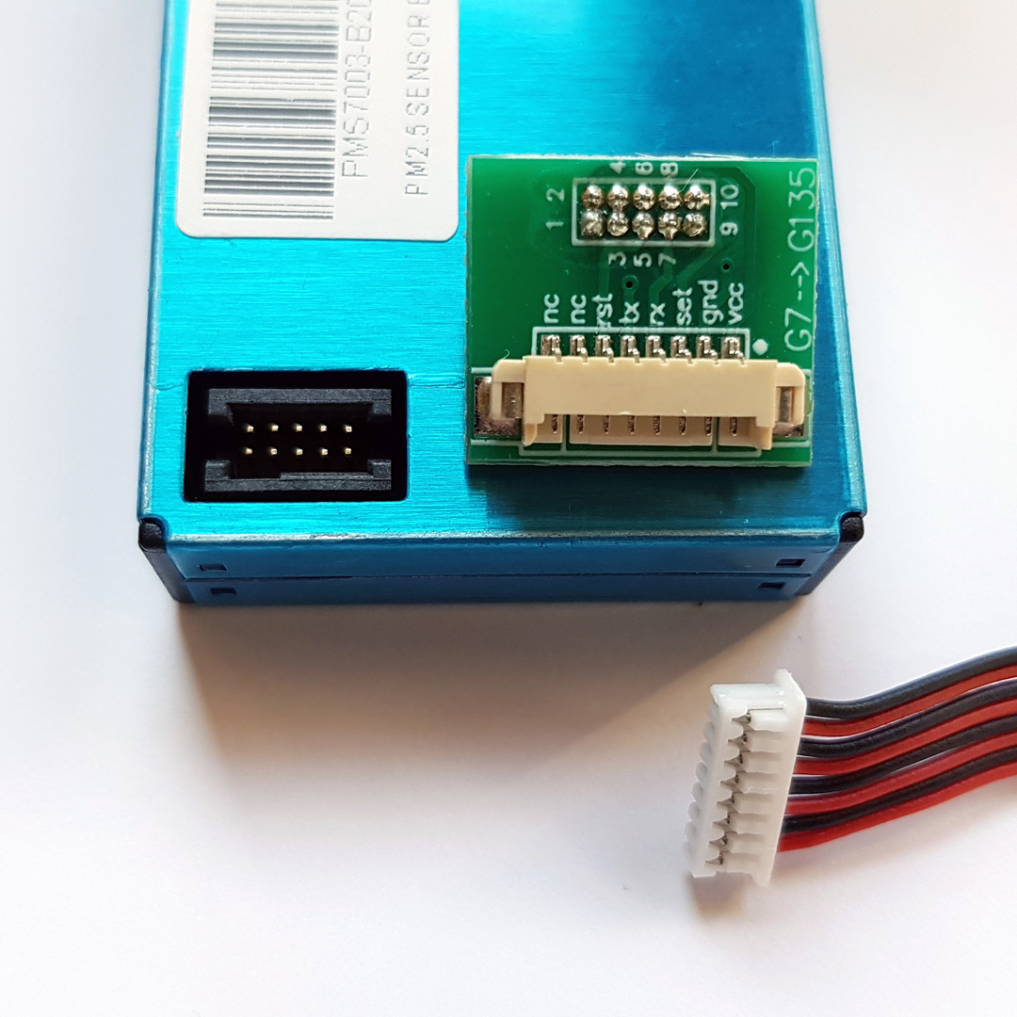
MAEER’s MIT Art, Design and Technology University, Pune
MIT School of Computing
Department of Computer Science and Engineering
Computer Engineering Workshop 23CSE1107
F.Y B.Tech [ASH] A.Y 2023-24 Sem-II
CEW Project Presentation
❖Sensor Working Principle
Name : PMS7003
Working principle:
The PMS7003 operates on the principle of laser scattering. It emits a laser beam into the air sample and detects the light scattered by particles passing through the beam. By analyzing the scattered light, it determines the concentration of particles in different size ranges, such as PM1.0, PM2.5, and PM10.
Specifications:
- Particle Size Range: PM1.0, PM2.5, PM10
- Measurement Principle: Laser scattering
- Measurement Range: 0.3 to 1.0 μm for PM1.0, 0.3 to 2.5 μm for PM2.5, 0.3 to 10 μm for PM10
- Measurement Accuracy: ±10%
- Output: Concentration in µg/m³ (micrograms per cubic meter)
- Response Time: ≤10 seconds
- Operating Voltage: 5V DC
- Operating Temperature Range: -10°C to 60°C
- Operating Humidity Range: 0% to 99% RH (non-condensing)
- Dimensions: 50mm x 46mm x 17mm
- Weight: Approximately 25 grams

Slide 13
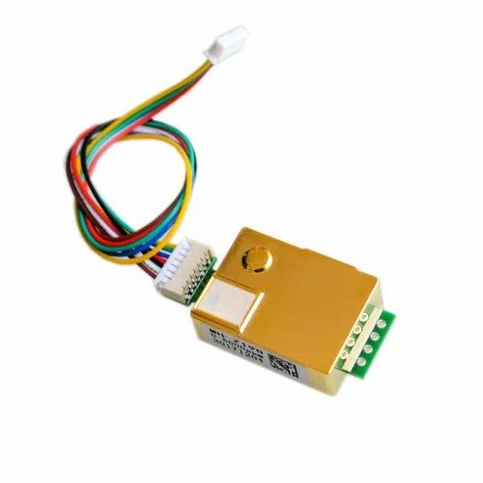
MAEER’s MIT Art, Design and Technology University, Pune
MIT School of Computing
Department of Computer Science and Engineering
Computer Engineering Workshop 23CSE1107
F.Y B.Tech [ASH] A.Y 2023-24 Sem-II
CEW Project Presentation
❖Sensor Working Principle
Name : MHZ19
Working Principle:
The MH-Z19 sensor operates based on the principle of NDIR spectroscopy. It contains an infrared light source, a gas sample chamber, and an infrared detector. When the infrared light passes through the gas sample chamber, it interacts with CO2 molecules, absorbing specific wavelengths of light. The amount of light absorbed is proportional to the concentration of CO2 in the sample. The infrared detector measures the intensity of light that passes through the chamber and calculates the CO2 concentration based on the absorption of infrared light by CO2 molecules.
Specifications:
- Measurement Range: 0 to 5000 ppm (parts per million)
- Measurement Principle: Nondispersive infrared (NDIR) spectroscopy
- Accuracy: ±50 ppm ±3% of reading
- Resolution: 1 ppm
- Response Time: <60 seconds
- Warm-up Time: <3 minutes
- Operating Voltage: 3.6V to 5.5V DC
- Operating Current: 18mA (average), 35mA (peak)
- Operating Temperature Range: 0°C to 50°C
- Operating Humidity Range: 0% to 95% RH (non-condensing)
- Dimensions: 33mm x 20mm x 8mm
- Weight: Approximately 5 grams

Slide 14
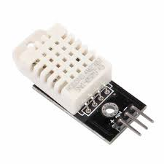
MAEER’s MIT Art, Design and Technology University, Pune
MIT School of Computing
Department of Computer Science and Engineering
Computer Engineering Workshop 23CSE1107
F.Y B.Tech [ASH] A.Y 2023-24 Sem-II
CEW Project Presentation
❖Sensor Working Principle
Name : DHT22
Working Pricniple:
The DHT22 sensor measures temperature and humidity using a capacitive humidity sensor and a thermistor. The humidity sensor changes its capacitance based on air moisture, converted to digital signals by an analog-to-digital converter. The thermistor detects temperature changes through resistance variation. The sensor's microcontroller processes these signals to output digital temperature and humidity readings.
Specifications:
- Temperature Measurement Range: -40°C to 80°C
- Temperature Measurement Accuracy: ±0.5°C
- Humidity Measurement Range: 0% to 100% RH (Relative Humidity)
- Humidity Measurement Accuracy: ±2% RH
- Resolution: 0.1°C for temperature, 0.1% RH for humidity
- Operating Voltage: 3.3V to 5.5V DC
- Operating Current: 0.3mA (standby), 2.5mA (active)
- Sampling Interval: 2 seconds (minimum)
- Response Time: 2 seconds (typical) for both temperature and humidity
- Output: Digital signal (single-wire serial interface)
- Dimensions: 15.1mm x 25mm x 7.7mm
- Weight: Approximately 3 grams

Slide 15
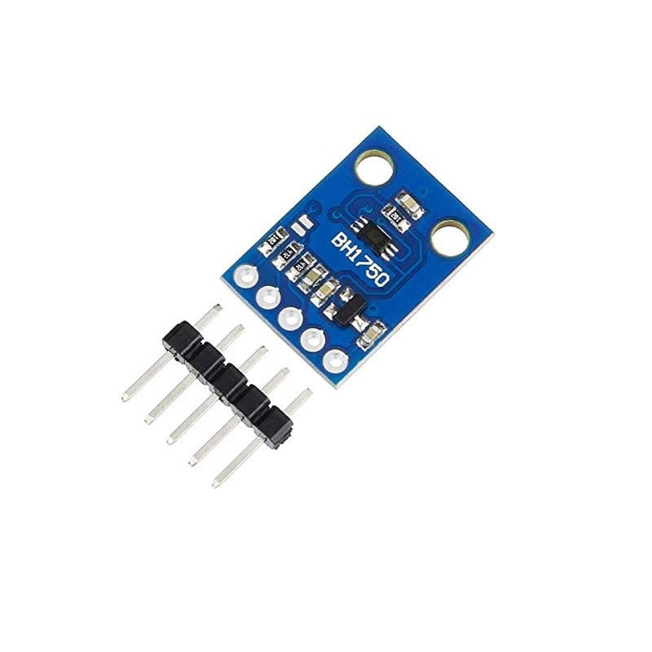
MAEER’s MIT Art, Design and Technology University, Pune
MIT School of Computing
Department of Computer Science and Engineering
Computer Engineering Workshop 23CSE1107
F.Y B.Tech [ASH] A.Y 2023-24 Sem-II
CEW Project Presentation
❖Sensor Working Principle
Name : BH1750
Working Principle:
The BH1750 sensor operates based on the principle of light intensity measurement using a photodiode. It contains a photodiode that converts light energy into electrical current. The sensor's internal circuitry amplifies and converts this current into a digital signal. The intensity of the digital signal is proportional to the amount of light falling on the photodiode. By measuring this digital signal, the sensor can determine the ambient light intensity.
Specifications:
- Measurement Range: 0 to 65535 lux
- Measurement Resolution: 1 lux
- Measurement Accuracy: ±20% (50 to 10000 lux)
- Operating Voltage: 2.4V to 3.6V DC
- Operating Current: 0.12mA (typical)
- Response Time: 16ms (typical)
- I2C Address: 0x23 or 0x5C (selectable)
- Operating Temperature Range: -40°C to 85°C
- Dimensions: 2.4mm x 2.4mm x 0.8mm (typical)
- Weight: Approximately 0.04 grams

Slide 16
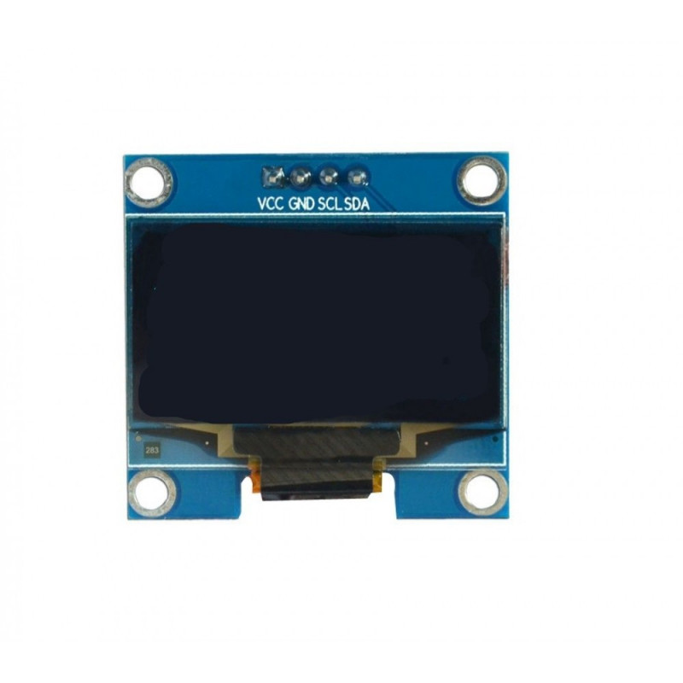
MAEER’s MIT Art, Design and Technology University, Pune
MIT School of Computing
Department of Computer Science and Engineering
Computer Engineering Workshop 23CSE1107
F.Y B.Tech [ASH] A.Y 2023-24 Sem-II
CEW Project Presentation
❖Indicator
Name : 0.96’ OLED
Working Principle:
An OLED display consists of thin organic layers sandwiched between two electrodes, namely the anode and the cathode. When an electric current is applied, electrons are injected from the cathode and holes from the anode into the organic layers. These electrons and holes combine in the emissive layer, causing organic compounds to emit light. The emitted light passes through the transparent anode and cathode, resulting in the display of images or text.
Specifications:
- Screen Size: 0.9 inches (diagonal)
- Resolution: Typically 128x32 pixels or 80x160 pixels
- Display Technology: OLED (Organic Light-Emitting Diode)
- Color Depth: Monochrome (typically white or blue)
- Interface: Typically SPI (Serial Peripheral Interface) or I2C (Inter-Integrated Circuit)
- Operating Voltage: Typically 3.3V or 5V
- Viewing Angle: Wide viewing angle, typically >160 degrees
- Operating Temperature Range: Typically -40°C to 80°C
- Dimensions: Varies depending on the specific model
- Weight: Lightweight, typically a few grams

Slide 17
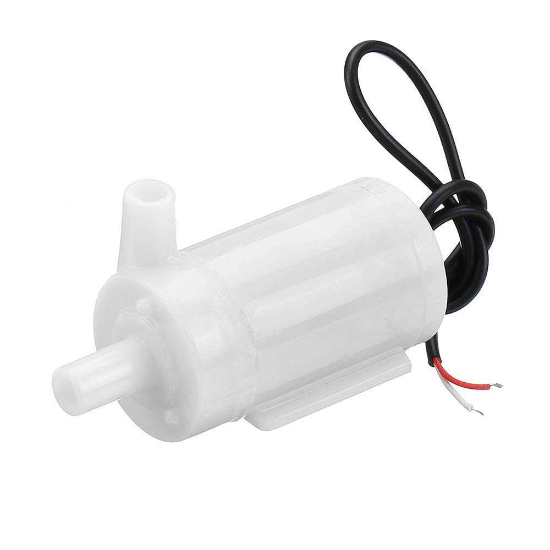
MAEER’s MIT Art, Design and Technology University, Pune
MIT School of Computing
Department of Computer Science and Engineering
Computer Engineering Workshop 23CSE1107
F.Y B.Tech [ASH] A.Y 2023-24 Sem-II
CEW Project Presentation
❖Actuator
Name : Pump
Working principle:
A 5-volt pump works by converting electrical energy into mechanical energy to move fluids. It operates using a small motor and an impeller or propeller to push fluid through its outlet.
Specifications:
- Voltage: 5 volts
- Flow Rate: Volume of fluid moved per unit time (e.g., liters per hour)
- Head: Maximum vertical lift height
- Operating Temperature Range: Suitable temperature range for operation
- Materials: Construction materials, especially those in contact with fluid
- Lifespan: Expected operational lifespan before maintenance or replacement.

Slide 18
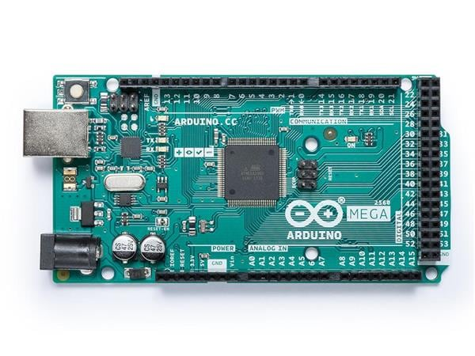
MAEER’s MIT Art, Design and Technology University, Pune
MIT School of Computing
Department of Computer Science and Engineering
Computer Engineering Workshop 23CSE1107
F.Y B.Tech [ASH] A.Y 2023-24 Sem-II
CEW Project Presentation
ARDUINO MEGA 2560
1. Microcontroller: It uses the ATmega2560 microcontroller.
2. Operating Voltage: 5V.
3. Input Voltage (recommended): 7-12V.
4. Input Voltage (limits): 6-20V.
5. Digital I/O Pins: 54 (of which 15 provide PWM output).
6. Analog Input Pins: 16.
7. DC Current per I/O Pin: 20 mA.
8. DC Current for 3.3V Pin: 50 mA.
9. Flash Memory: 256 KB, of which 8 KB is used by the bootloader.
10. SRAM: 8 KB.
11. EEPROM: 4 KB.
12. Clock Speed: 16 MHz.
13. Length: 101.52 mm.
14. Width: 53.3 mm.
15. Weight: 37 g.
16. USB Interface: ATmega16U2 (on the rev3 version).
17. Power Supply: Can be powered via USB connection or an external power supply.
18. Reset Button Included for resetting the microcontroller.
19. Operating Temperature: 0°C to 85°C.
20. Development Environment: Compatible with the Arduino IDE and other development environments supporting Arduino programming.

Slide 19
MAEER’s MIT Art, Design and Technology University, Pune
MIT School of Computing
Department of Computer Science and Engineering
Computer Engineering Workshop 23CSE1107
F.Y B.Tech [ASH] A.Y 2023-24 Sem-II
CEW Project Presentation
❖Results
1. Microalgae-Based Purification System:
We created an air purifier that uses microalgae to clean the air.
2. Effective Pollution Reduction:
Our tests showed significant improvements in air quality metrics like carbon dioxide, PM.
3. Environmental Impact Assessment:
We found that our system can improve environmental sustainability and public health.
4. Scalability:
Our research shows that our solution can be implemented in different residential areas.
5. Contribution to Knowledge:
We've added valuable insights to the field of sustainable air purification solutions for residential areas.

Slide 20
MAEER’s MIT Art, Design and Technology University, Pune
MIT School of Computing
Department of Computer Science and Engineering
Computer Engineering Workshop 23CSE1107
F.Y B.Tech [ASH] A.Y 2023-24 Sem-II
CEW Project Presentation
❖Conclusion:
Our project offers a promising solution to world’s air pollution problem by harnessing the natural purifying abilities of microalgae. We've developed a microalgae-based air purifier that effectively cleans the air while minimizing energy use and maintenance. This innovation has the potential to create cleaner and healthier residential environments while reducing the carbon footprint of traditional purification methods.

Slide 21
MAEER’s MIT Art, Design and Technology University, Pune
MIT School of Computing
Department of Computer Science and Engineering
Computer Engineering Workshop 23CSE1107
F.Y B.Tech [ASH] A.Y 2023-24 Sem-II
CEW Project Presentation
Thank You
Any Questions ?!!!

